Slide 1
Mobile application project on marker based Augmented reality implementing coloring textures Library on a shooter game.
Norman Lista

Slide 2
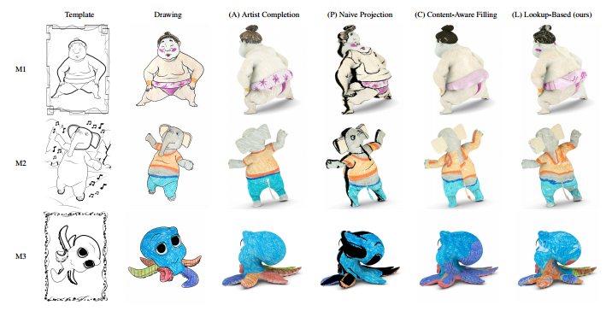
What is the coloring texture about?
Renders a texture live on a 3d object
Taking it from an existing image.
-It process the image
-Creates the AR 3d object from a
template Selection that match the
image
-Tracks the surface of the image
-Creates the texture
-Renders the AR Mesh

Slide 3
Tools for development
Unity 3d development platform
Vuforia Augmented reality platform on Unity
Región capture package

Slide 4
Application: Super Duck shooter
A Shooter game that implements the texture coloring for unique features
The character is selected with the marker and can be customize by coloring it
The character shoots bullets when the screen is touched , and the player must use them to bring down figures and pass through.

Slide 5
Tools for development
Unity 3d
Vuforia AR tools
Color Texturing package (region capture) from Computer Vision

